Slide 1

0
WHY VUE ?
1
DATA BINDING
ROADMAP
2
METHODS & EVENTS
3
LOOPS / IF/ELSE
X
VUTIFY
4
COMPUTED & WATCHERS
FINAL
9
AUTHENTICATION
5
CLI
MIDTERM
COMPONENTS
8
SLOTS / WIDGETS
6
7
ROUTING

Slide 2

VUE
WATCHERS
&
LIFE CYCLE

Slide 3

What will we learn?
watch :{}
How to use watchers
What are the different phases of a Vue app ?
created
mounted
destroyed
Connect front end and back end !

Slide 4


EXPLAIN
What is a watcher?
just a LISTENER on a VALUE !
10 MIN
CLASS
A watcher is function that is executed when a data changes
data() {
return {
name : ‘’,
};
}
watch : {
name() {}
}
Whenever name changes, name() function is executed

Slide 5
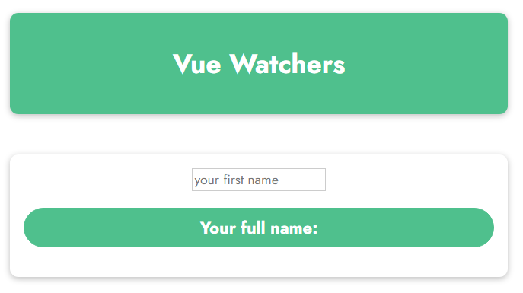
DEMO
1 -demo - watch
10 MIN
CLASS
Let‘s do the same Full Name data
But this time using watchers!

Slide 6

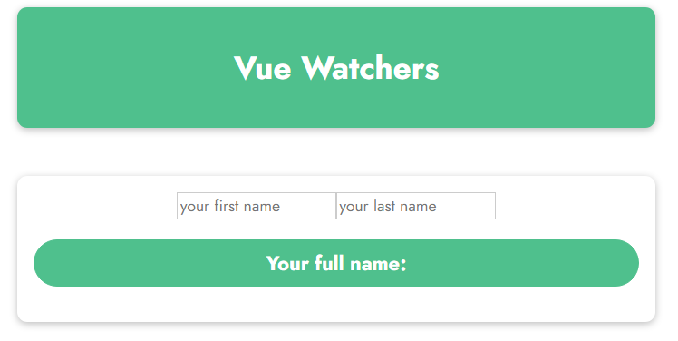
PRACTICE
Activity 1
10 MIN
TEAM 2
Do this activity in 2 ways :
Using computed
Using watchers
Discuss with your team compare which way is the nicest
RONAN OGOR
Display the first and last name in uppercase

Slide 7
PRACTICE
Activity 1
10 MIN
TEAM 2
Do this activity in 2 ways :
Using computed
Using watchers
Discuss with your team compare which way is the nicest
COMPUTED IS THE BEST
FOR THIS CASE
Display the first and last name in uppercase
RONAN OGOR

Slide 8
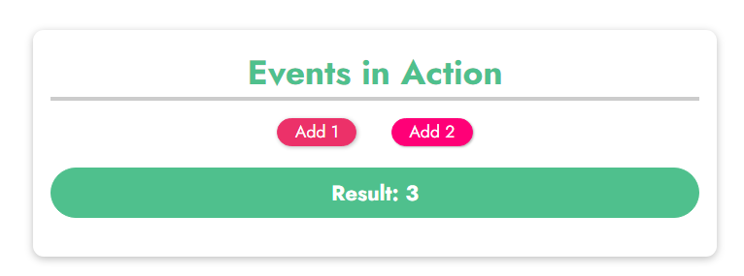
PRACTICE
Activity 2
10 MIN
TEAM 2
Can you do this activity:
Using computed?
Using watchers?
If result is greater or equal to 10, reset it to 0

Slide 9
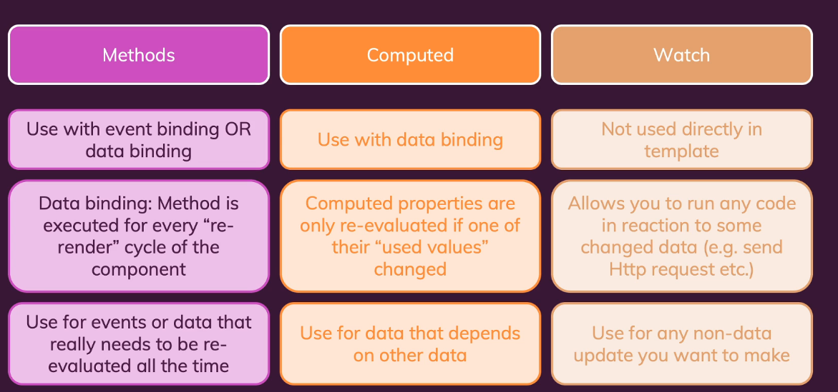
Method >> Computed >> Watch

Slide 10
Method >> Computed >> Watch

Slide 11
Method >> Computed >> Watch

Slide 12
EXPLAIN
Vue Lifecycles Hooks
10 MIN
CLASS
VueJS provides some methods (called lifecycle hooks) to manipulate your app at specific phases
Examples of phases during VueJS lifecycle :
When VueJS creates DOM from the template
When VueJS updates the DOM when a data changes

Slide 13
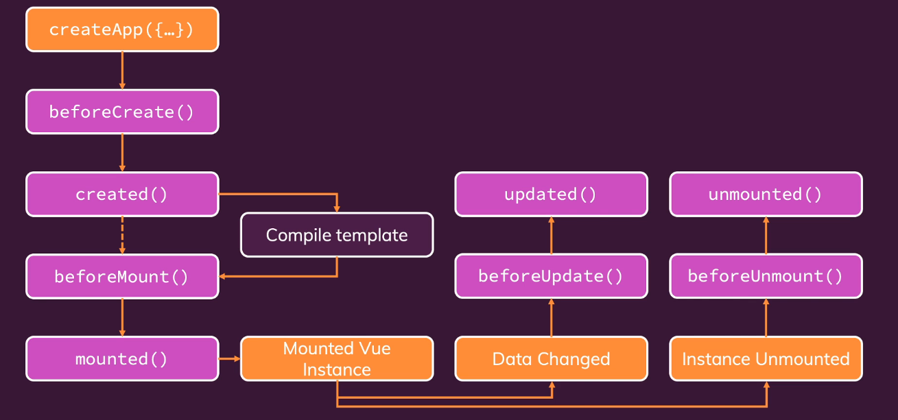
Vue Lifecycles

Slide 14
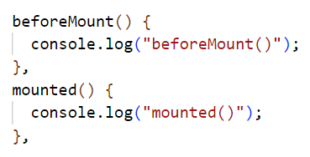
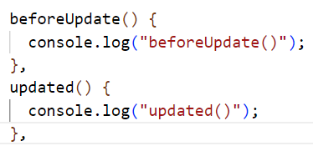
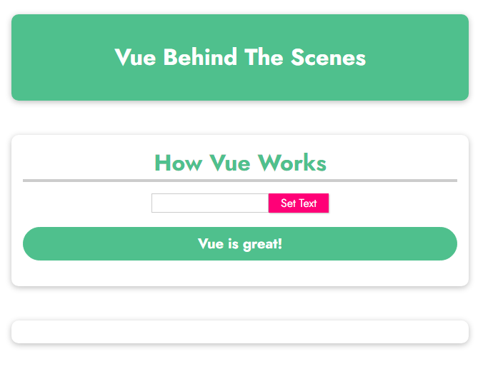
PRACTICE
Activity 3
10 MIN
TEAM 2
Let’s listen before/after the app is mounted
2. Let’s listen before/after the app is updated

Slide 15
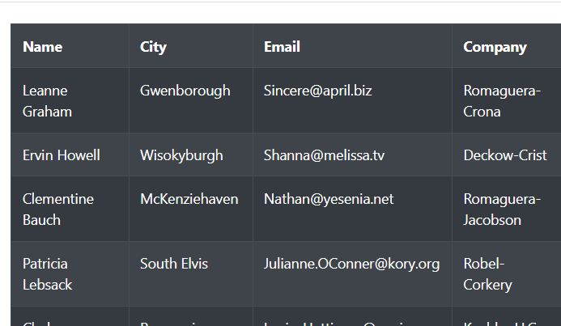
DEMO
4 - demo -fetch
10 MIN
CLASS
Get data from
https://jsonplaceholder.typicode.com/users/
Display data on view

Slide 16
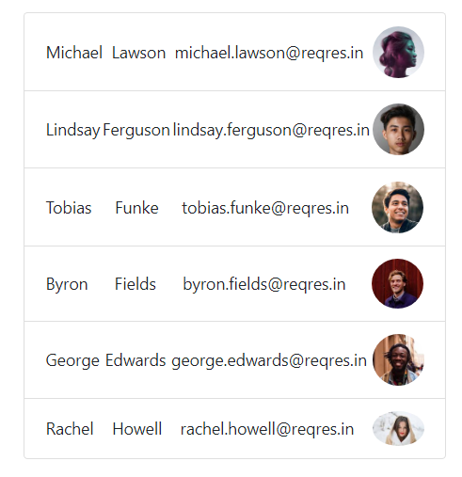
PRACTICE
Activity 4
10 MIN
INDV
Get data from
https://reqres.in/api/users?page=2
Display data on view

Slide 17
What we learnt
watch :{}
How to use watchers
What are the different phases of a vue app ?
created
mounted
destroyed
Connect front end and back end !

